Slide 1


Erbium Doped Fiber Amplifier (EDFA) Gain Modeling by Machine Learning
Presented By: ANIL KUMAR RAIGAR
Supervisor: Md Saifuddin Faruk
Bangor University | 2024

Slide 2
OUTLINE
Introduction
Aim and objective
Methodology
Results
Conclusion
Thank You
Bangor University | 2024

Slide 3
INTRODUCTION
Erbium-Doped Fiber Amplifiers (EDFAs) are essential for signal amplification in optical communication systems.
Traditional models often struggle to predict EDFA gain accurately due to nonlinear dynamics.
This study introduces Deep Neural Networks (DNN) to improve prediction accuracy.
The DNN model outperforms conventional methods.
Enhanced efficiency and reliability for high-capacity optical networks are achieved.
Bangor University | 2024

Slide 4
AIM AND OBJECTIVE
Develop a deep neural network to accurately predict EDFA gain, achieving high precision with performance metrics such as MAE and MSE.
Optimize the neural network architecture by implementing Leaky ReLU activation with alpha=0.1 applying to minimize overfitting and enhance generalization.
Evaluate the model's performance by comparing predicted vs. actual EDFA gain, calculating MSE, MAE, and analyzing prediction error across various channels and wavelengths.
Bangor University | 2024

Slide 5
METHODOLOGY- I
Data Preprocessing: Convert data from JSON to CSV, normalize it, and handle missing values for model training, based on the structure of the EDFA Gain Modeling Dataset.
Feature Engineering: Create new features like effective input power for better model accuracy.
Model Development: Build a Deep Neural Network (DNN) with multiple layers and Leaky ReLU activation.
Training & Optimization: Train the model using RMSprop and Adam optimizers, applying dropout for regularization.
Model Evaluation: Validate performance using cross-validation, MAE, and MSE metrics across multiple datasets​
Bangor University | 2024

Slide 6
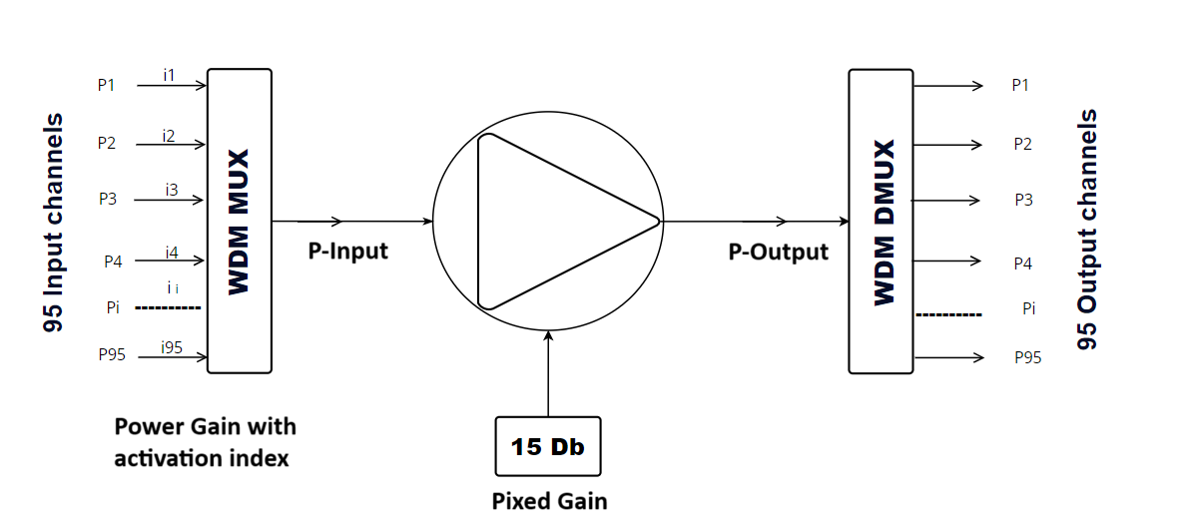
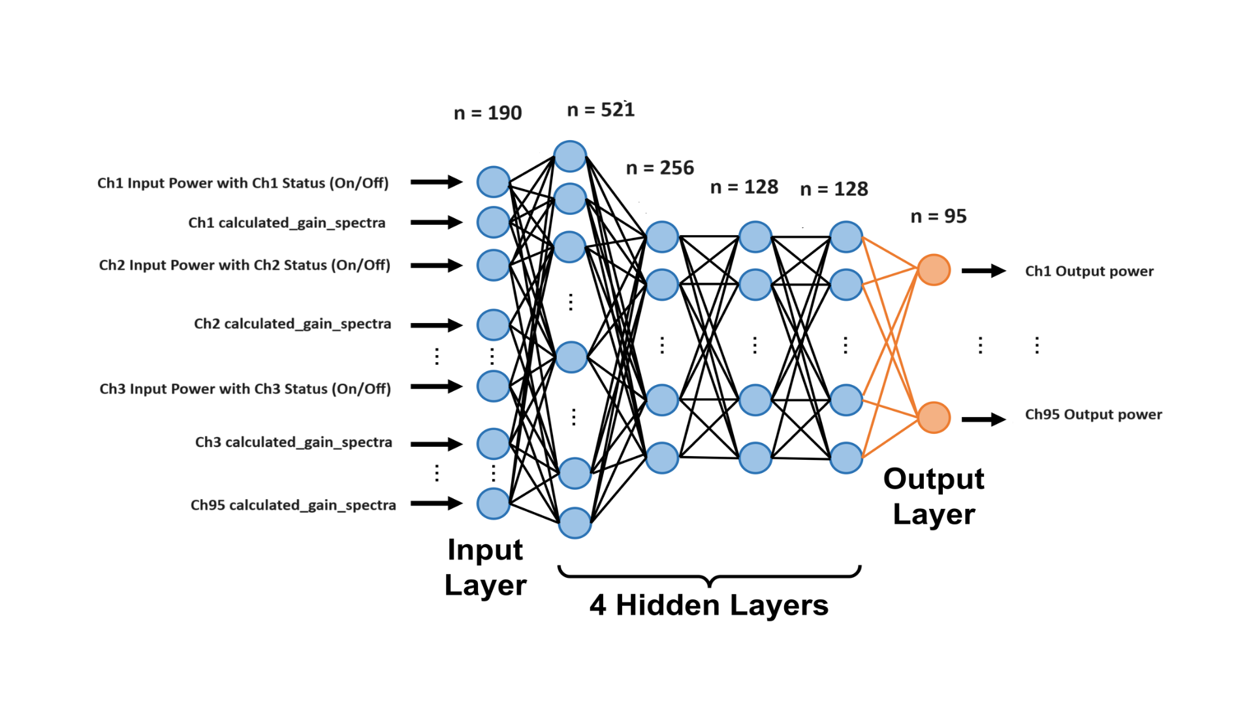
METHODOLOGY- II
The images show a 95-channel wavelength division multiplexing (WDM) system. On the left, a WDM multiplexer combines input signals, which are amplified and output through a demultiplexer. On the right, a deep neural network with four hidden layers predicts the output power for each channel using input power, channel status, and calculated gain spectra as inputs, producing 95 output channels.
Bangor University | 2024

Slide 7
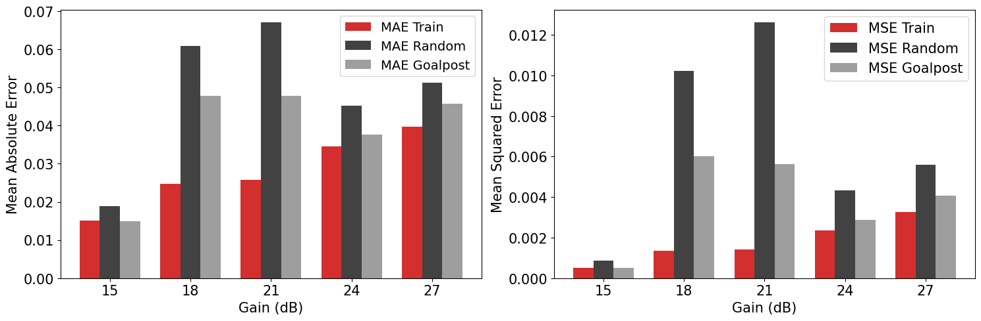
﻿RESULT
The model's performance at different gain levels shows significant improvements:
The MAE and MSE plots show the error metrics across 15, 18, 21, 24, and 27 gain levels. At 15 dB, the MAE is 0.0151 and the MSE is 0.0005, both of which are the lowest. The highest values are observed at 21 dB, where MAE reaches 0.0671 and MSE peaks at 0.0126.
Bangor University | 2024

Slide 8
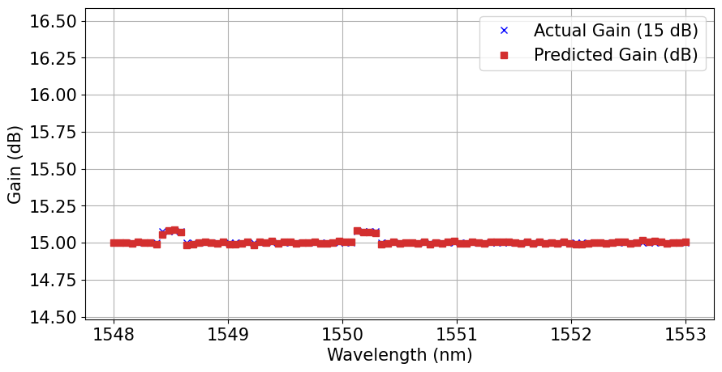
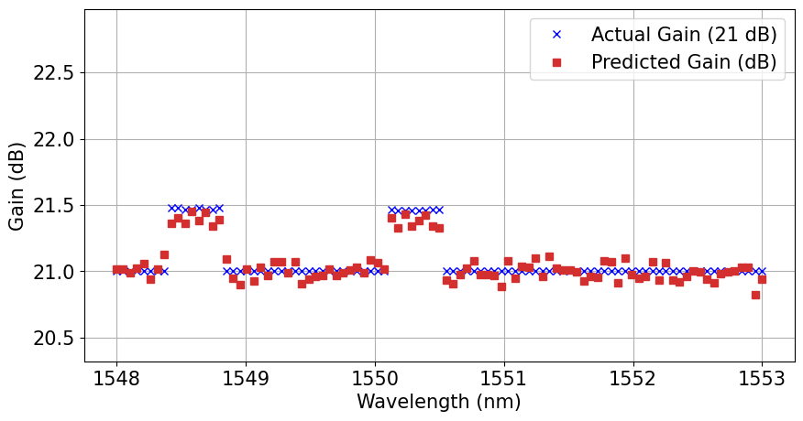
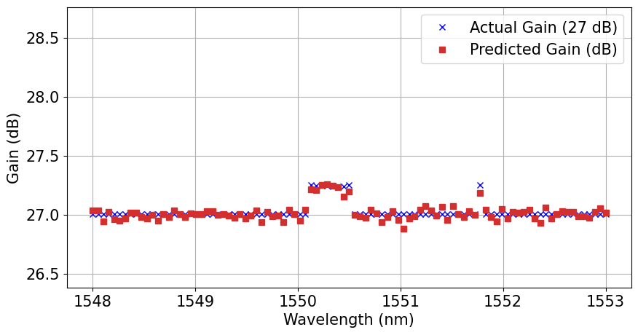
Comparison of Actual vs Predicted Gain Spectra for Different dB Levels Across Wavelengths
Figure A
Figure B
Figure C
The plots A, B, and C compare actual and predicted gain spectra for 15 dB, 21 dB, and 27 dB across wavelengths. At 15 dB, the predicted gain closely follows the actual gain around 15 dB with minor deviations. Similarly, at 21 dB and 27 dB, the predicted gain matches the actual gain with slight variations, staying within the ranges of approximately 21.0 to 21.6 dB and 26.8 to 27.4 dB, respectively.
Bangor University | 2024

Slide 9
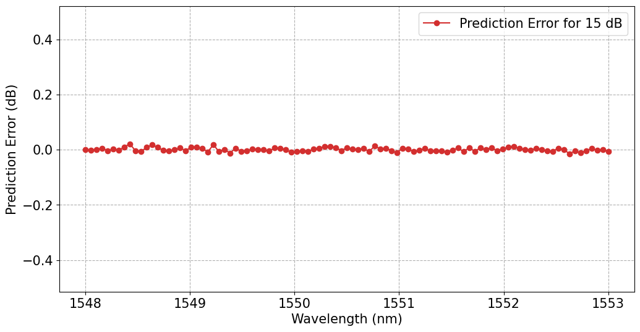
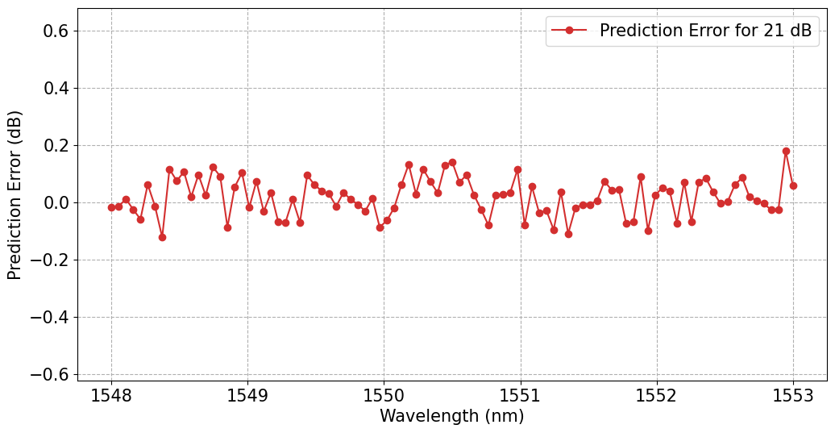
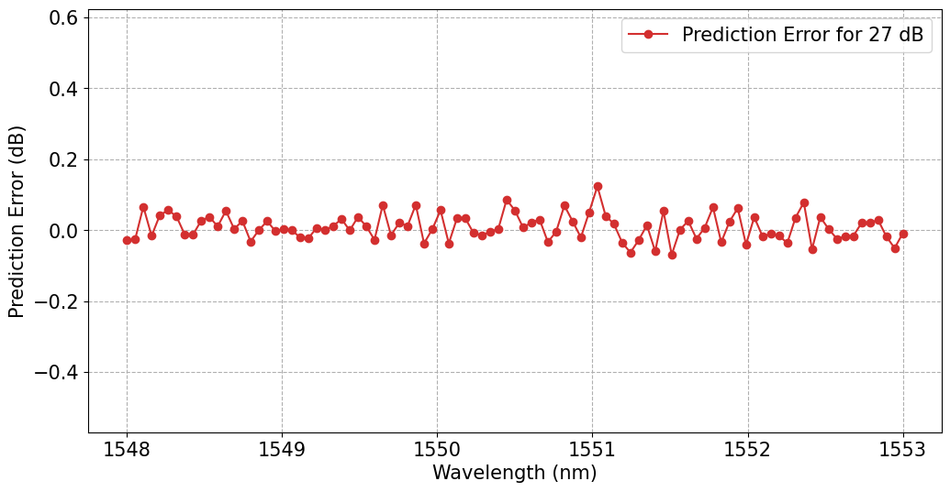
Prediction Error Across Different dB Levels and Wavelengths
Figure: Prediction error with 15dB
Figure: Prediction error with 21dB
Figure: Prediction error with 15dB
The plots show the prediction error for gain at 15 dB, 21 dB, and 27 dB across various wavelengths. The errors remain mostly within ±0.1 dB for 15 dB and 27 dB, indicating a strong match between actual and predicted values. However, the error increases to around ±0.2 dB at certain wavelengths for 21 dB. These plots illustrate the model's overall accuracy, with small deviations observed across the different dB levels and wavelengths.
Bangor University | 2024

Slide 10

CONCLUSION
We have successfully done EDFA Gain modeling. the neural network model improved EDFA gain prediction accuracy, achieving MAE of 0.0151 and MSE of 0.0005.
It performed reliably across various test scenarios, with MAE of 0.0188 for test data.
Future work will explore advanced ML and AI techniques like LSTM and Transformers for more accurate and efficient predictions.
Bangor University | 2024

Slide 11
Bangor University | 2024
THANK YOU
Presented By : Anil Kumar Raigar

